Slide 1
Module 22

Slide 2
Excretion
Biochemical reactions constantly occur in the cells of a living organism.
Chemical reactions in the cells

Slide 3
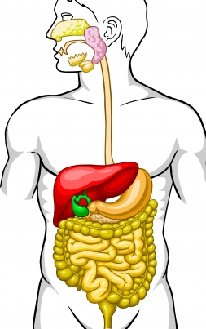

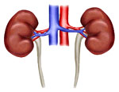
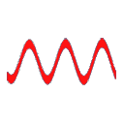

After digestion the food is carried to the cells by the blood
Kidneys
Food
The kidneys filter the blood and remove the waste products in the form of urine.
Urine
These products if allowed to acculmulate in the body may cause serious damage, sometimes leading to death.
Therefore, they need to be eliminated from the body.
So, the blood carries them to the kidneys.
But along with the required substances, it also produces harmful substances like
Inside the cell energy is produced from food in the form of ATP.
Urea, uric acid and ammonia.
Harmful products
Blood
cell

Slide 4
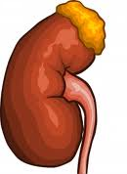
Pair of kidneys
The excretory
System in human beings includes …..
From the kidneys two thin tubes come out called as ureters
Both the ureters open in a bag like organ called urinary bladder
Pair of
ureters
The urinary bladder opens into a small tube like structure called urethra.
Urinary bladder
Urethra

Slide 5
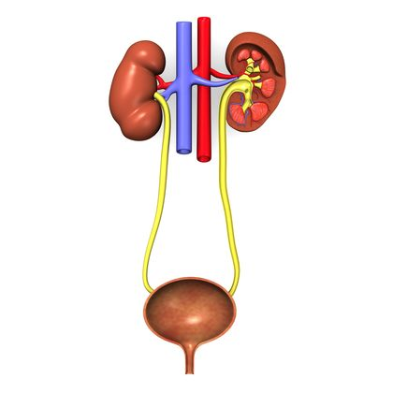
The human excretory system
The artery that carries blood to the kidneys is called as renal artery.
Renal vein
Renal artery
Kidney
The vein that carries blood from the kidneys is called as renal vein.
Ureter
Urinary bladder
Urethra
..Diagram

Slide 6
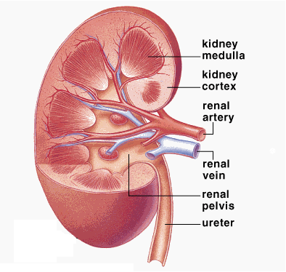
Let us have a look at the vertical section of the kidney.
The triangular region is called as
Kidney medulla
The region out side the medulla is called as
Kidney cortex
The region where the ureter begins is called as
Renal artery
Renal vein
Renal pelvis
Ureter
..Diagram

Slide 7
Thank You

